Slide 1
Section 13.2 Investment return of MPF accounts (annualized and cumulative)
data from Power BI matches with MPFA Report. FS_Reporting to MPFA_Fund flow
CIR = PM_GAIN_LOSS / PM_TOTAL_CONTR_AMT
AIR = POWER(1+ CIR, 12 / PM_ACCT_MTHS) -1,
where PM_ACCT_MTHS = No. of Months between Member Account Effective Date and Report Month
Remark:
PM_TOTAL_CONTR_AMT (blue box) and PM_GAIN_LOSS (green) are calculated by the system directly which it is shown in EE Portal.
A daily record (PM_BAL_DATE) is calculated in the system and it refers to the cumulative balance and investment gain(loss).
If calculating the average CIR/ AIR in a different REPORTING PEPIOD i.e. 3 Months etc, it is to select the corresponding PM_BAL_DATE records (i.e. last record in each month) and take an average for each member.
PM_TOTAL_CONTR_AMT
PM_GAIN_LOSS

Slide 2
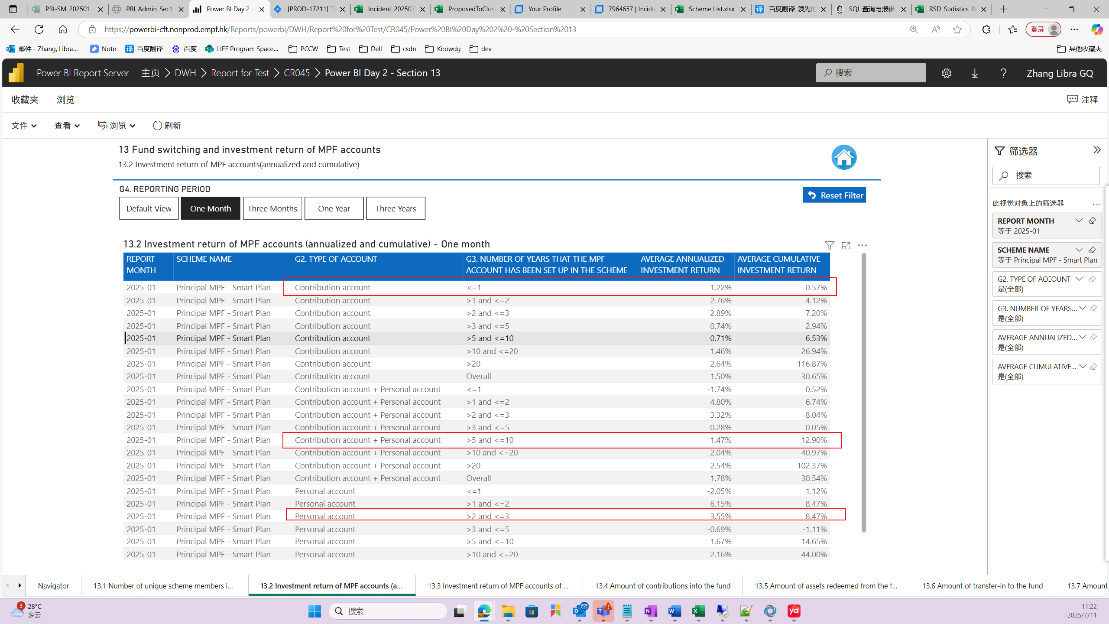
Section 13.2 Investment return of MPF accounts (annualized and cumulative)
One Month
❶
❷
❸
❹
❺
❻

Slide 3
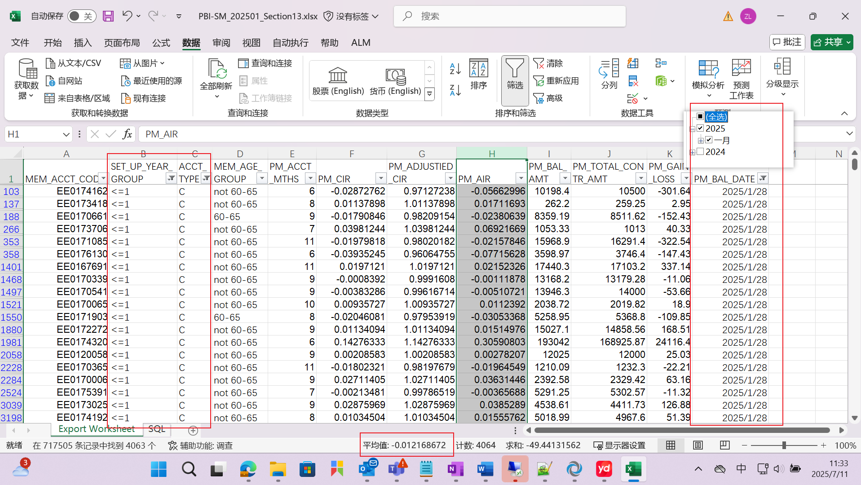
❶
One Month:
Average AIR of “Contribution account + number of years <=1”

Slide 4
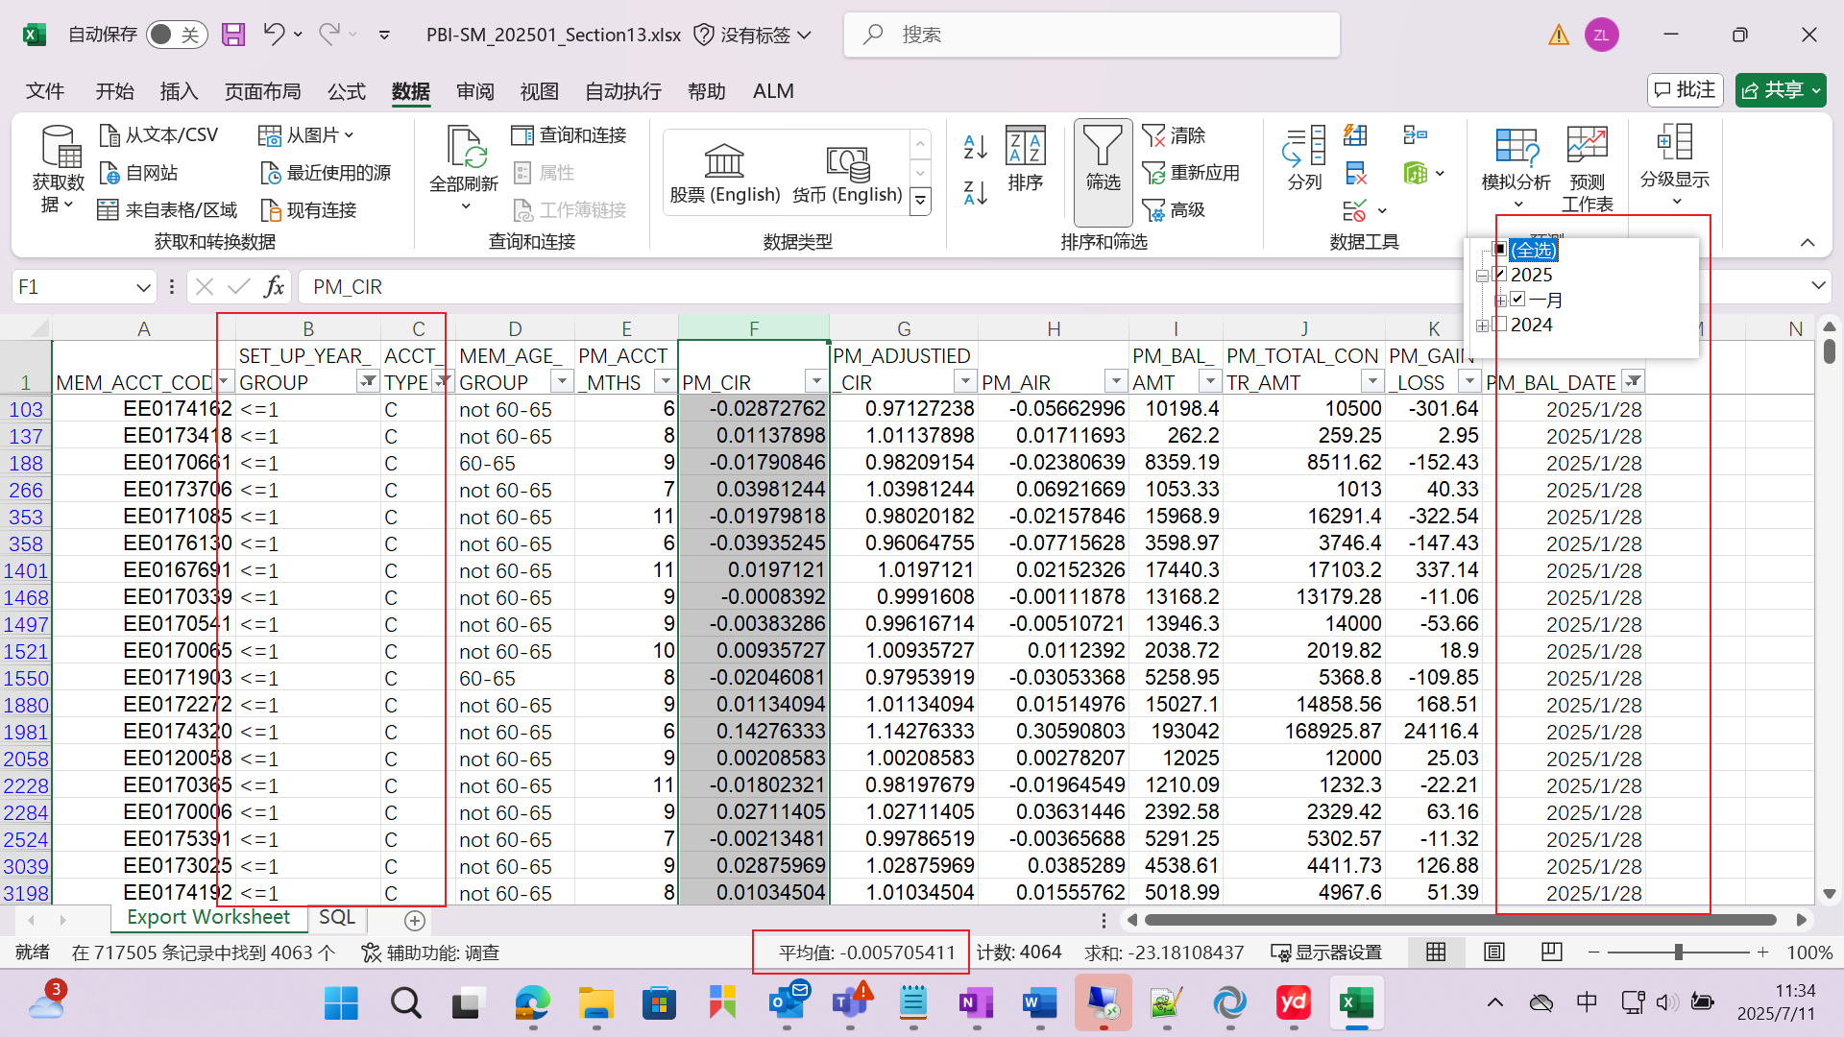
❷
One Month:
Average CIR of “Contribution account + number of years <=1”

Slide 5
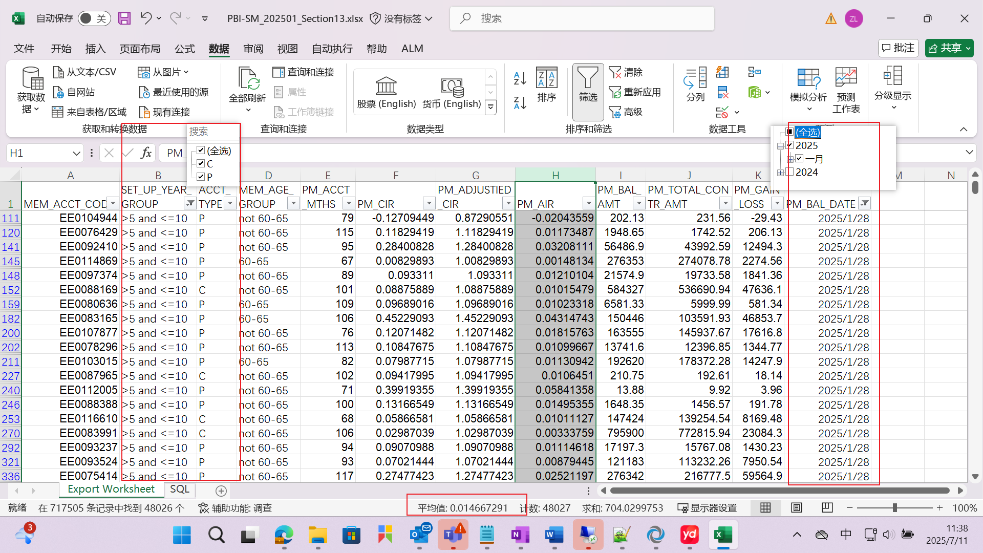
❸
One Month:
Average AIR of “(Contribution account + Personal account) + (number of years: >5 and <=10)”

Slide 6
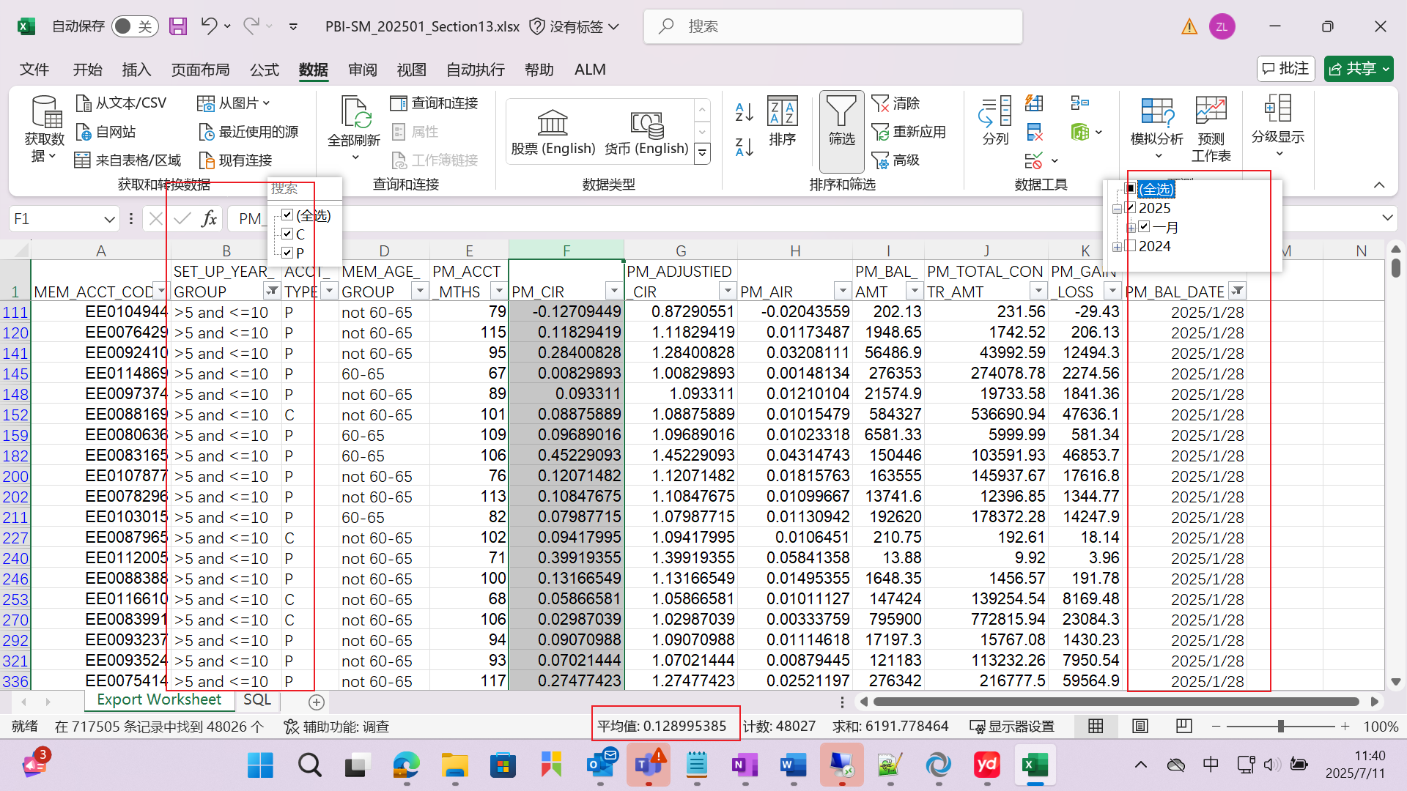
❹
One Month:
Average CIR of “(Contribution account + Personal account) + (number of years: >5 and <=10)”

Slide 7
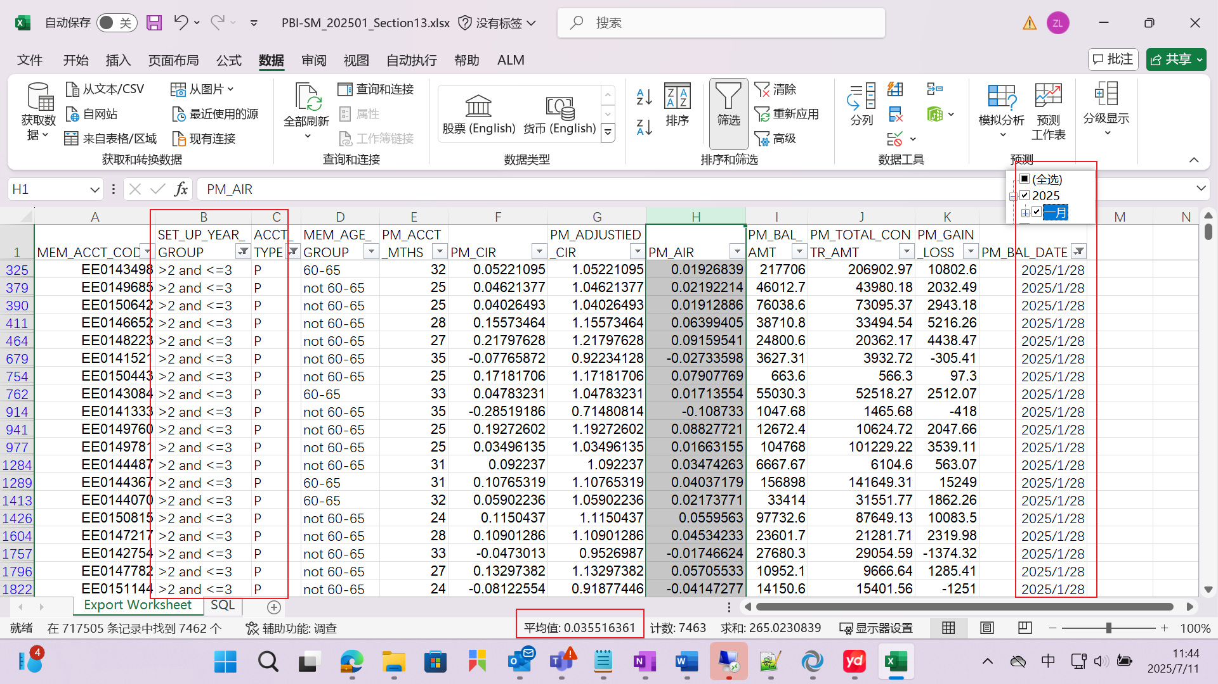
❺
One Month:
Average AIR of “Personal account + (number of years: >2 and <=3)”

Slide 8
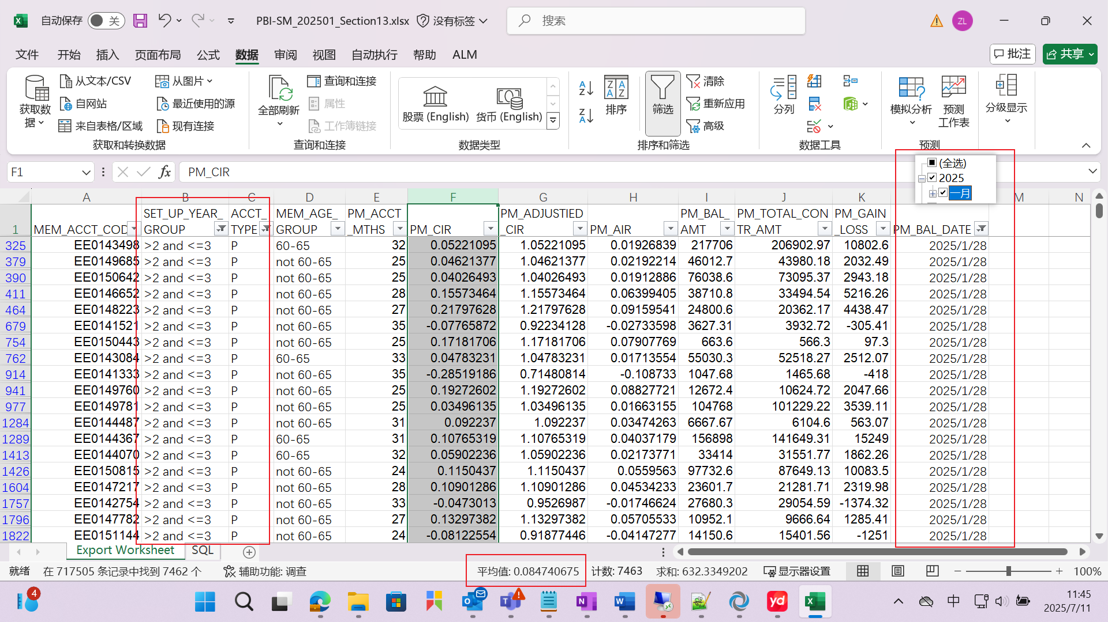
❻
One Month:
Average CIR of “Personal account + (number of years: >2 and <=3)”

Slide 9
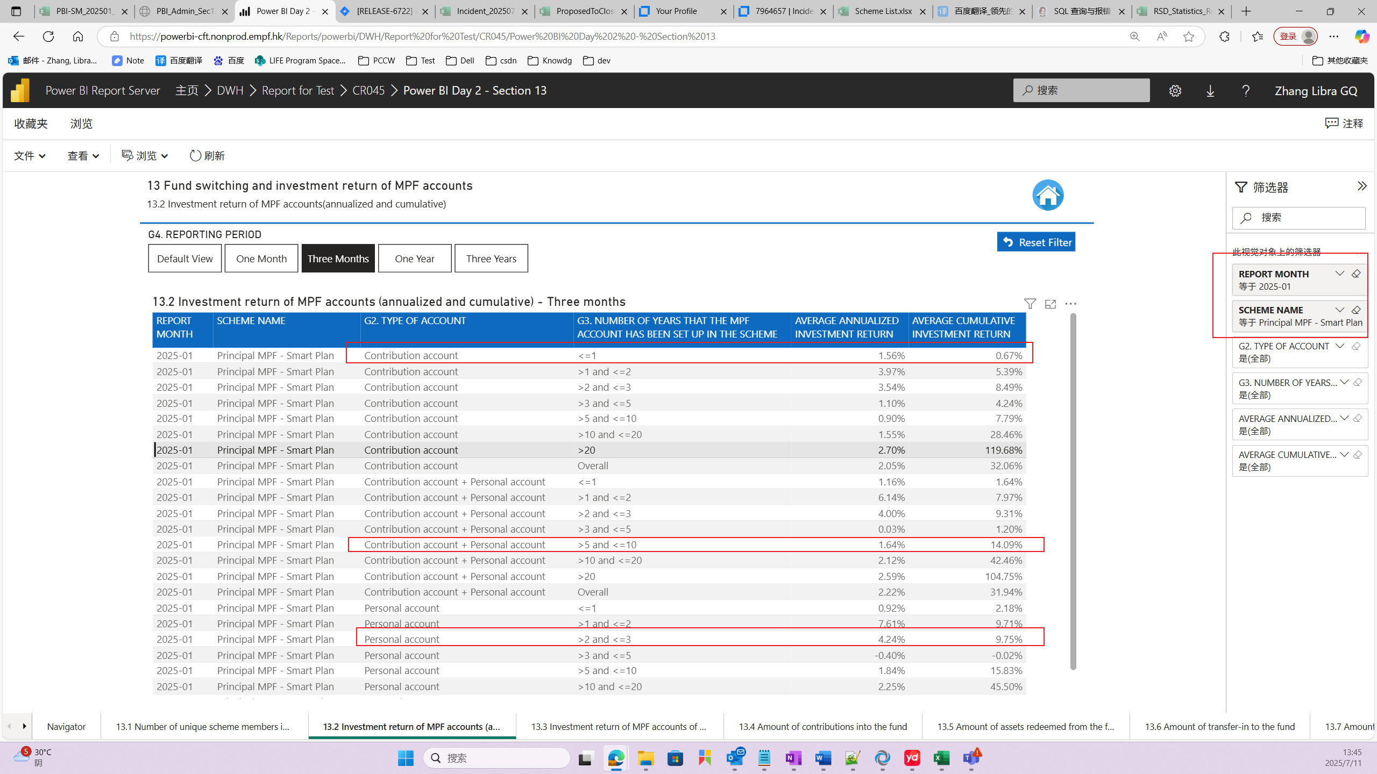
Section 13.2 Investment return of MPF accounts (annualized and cumulative)
3 Months
❼
❽
❾
❿
11
12

Slide 10
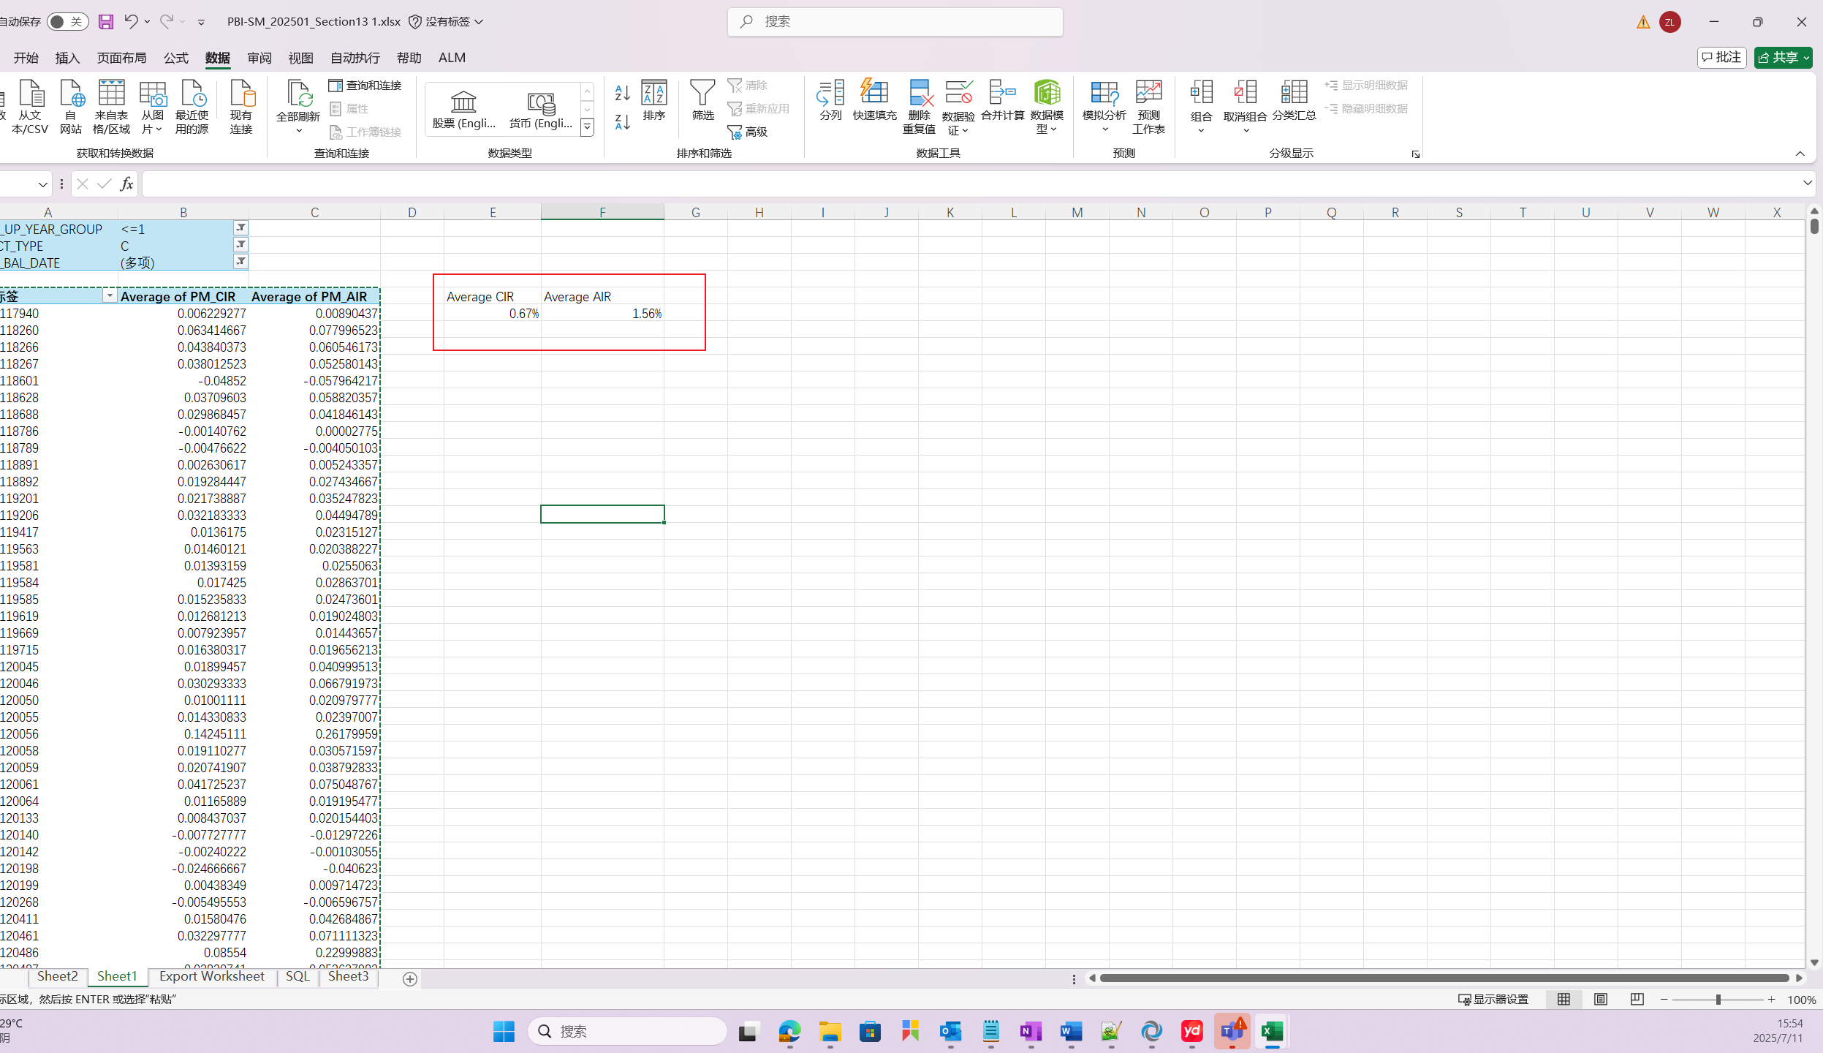
❼
Three Month:
Average AIR of “Contribution account + number of years <=1”

Slide 11
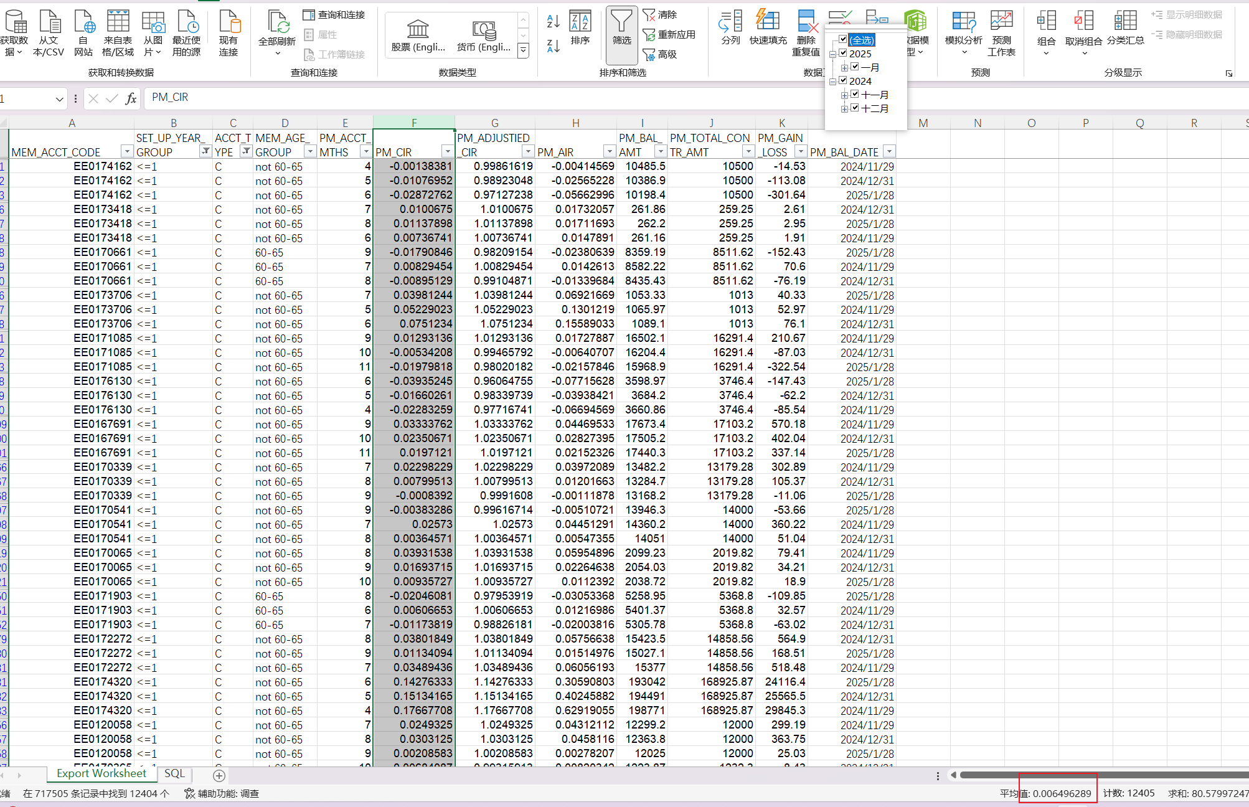
❽
Three Month:
Average CIR of “Three Months + Contribution account + number of years <=1”

Slide 12
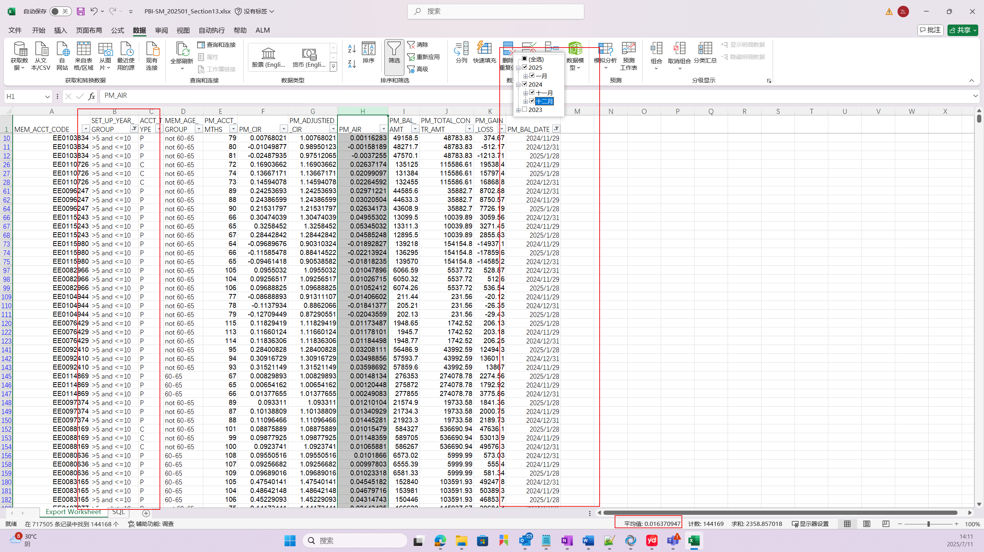
❾
Three Month:
Average AIR of “Three Months + (Contribution account + Personal account) + (number of years: >5 and <=10)”

Slide 13
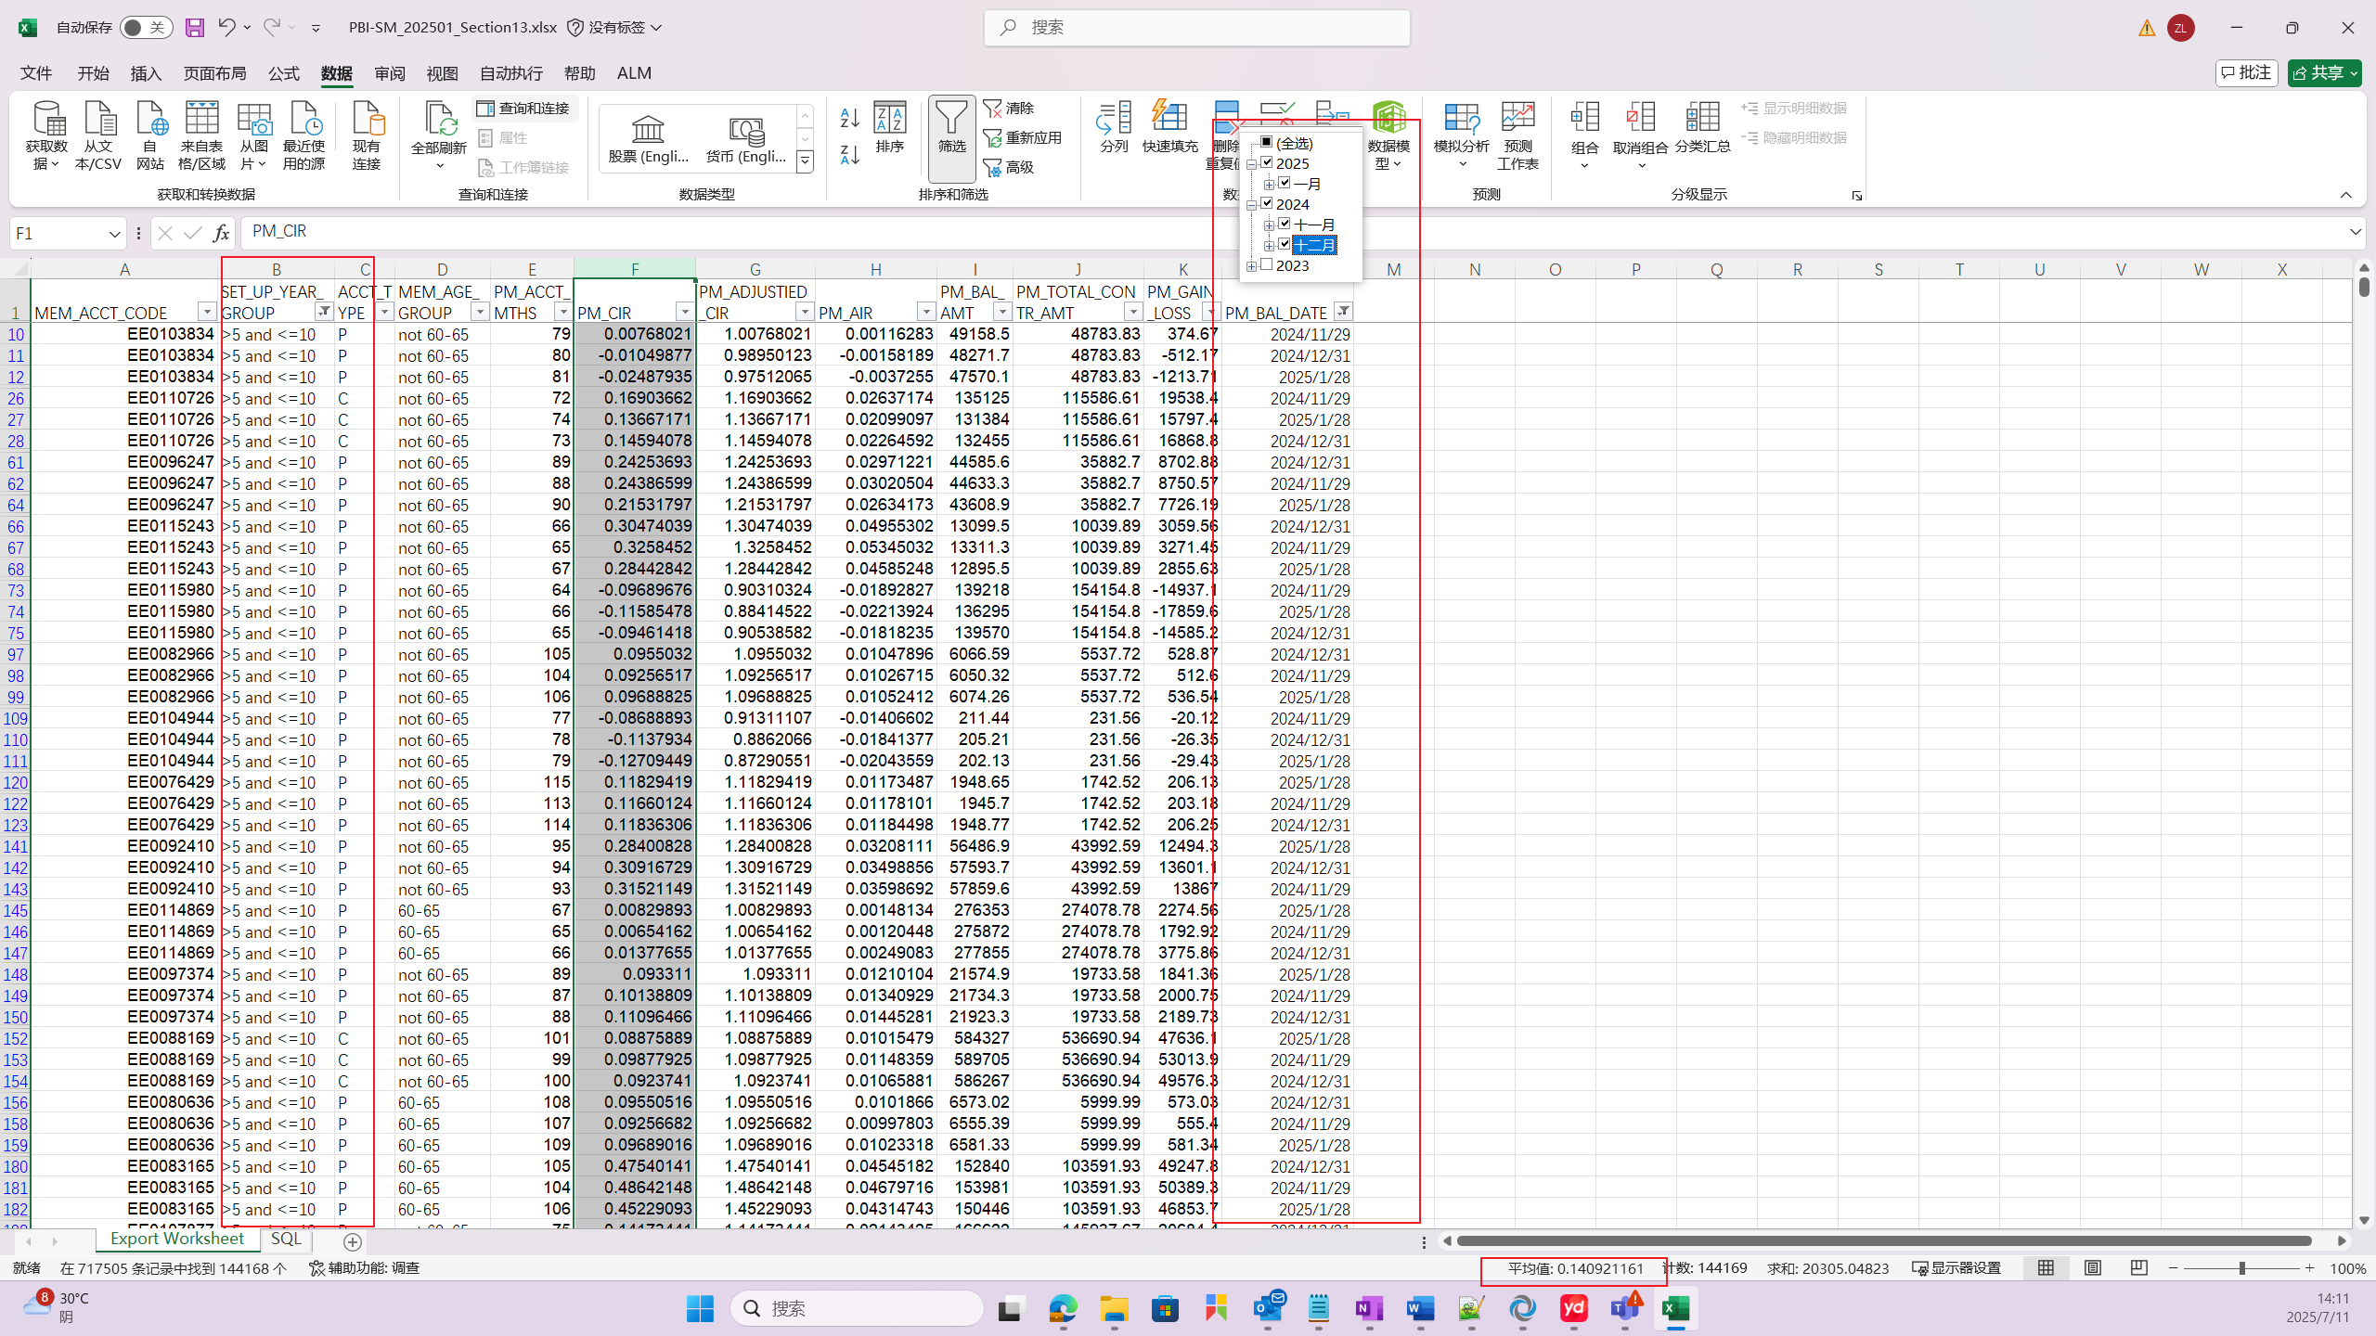
❿
Three Month:
Average CIR of “Three Months + (Contribution account + Personal account) + (number of years: >5 and <=10)”

Slide 14
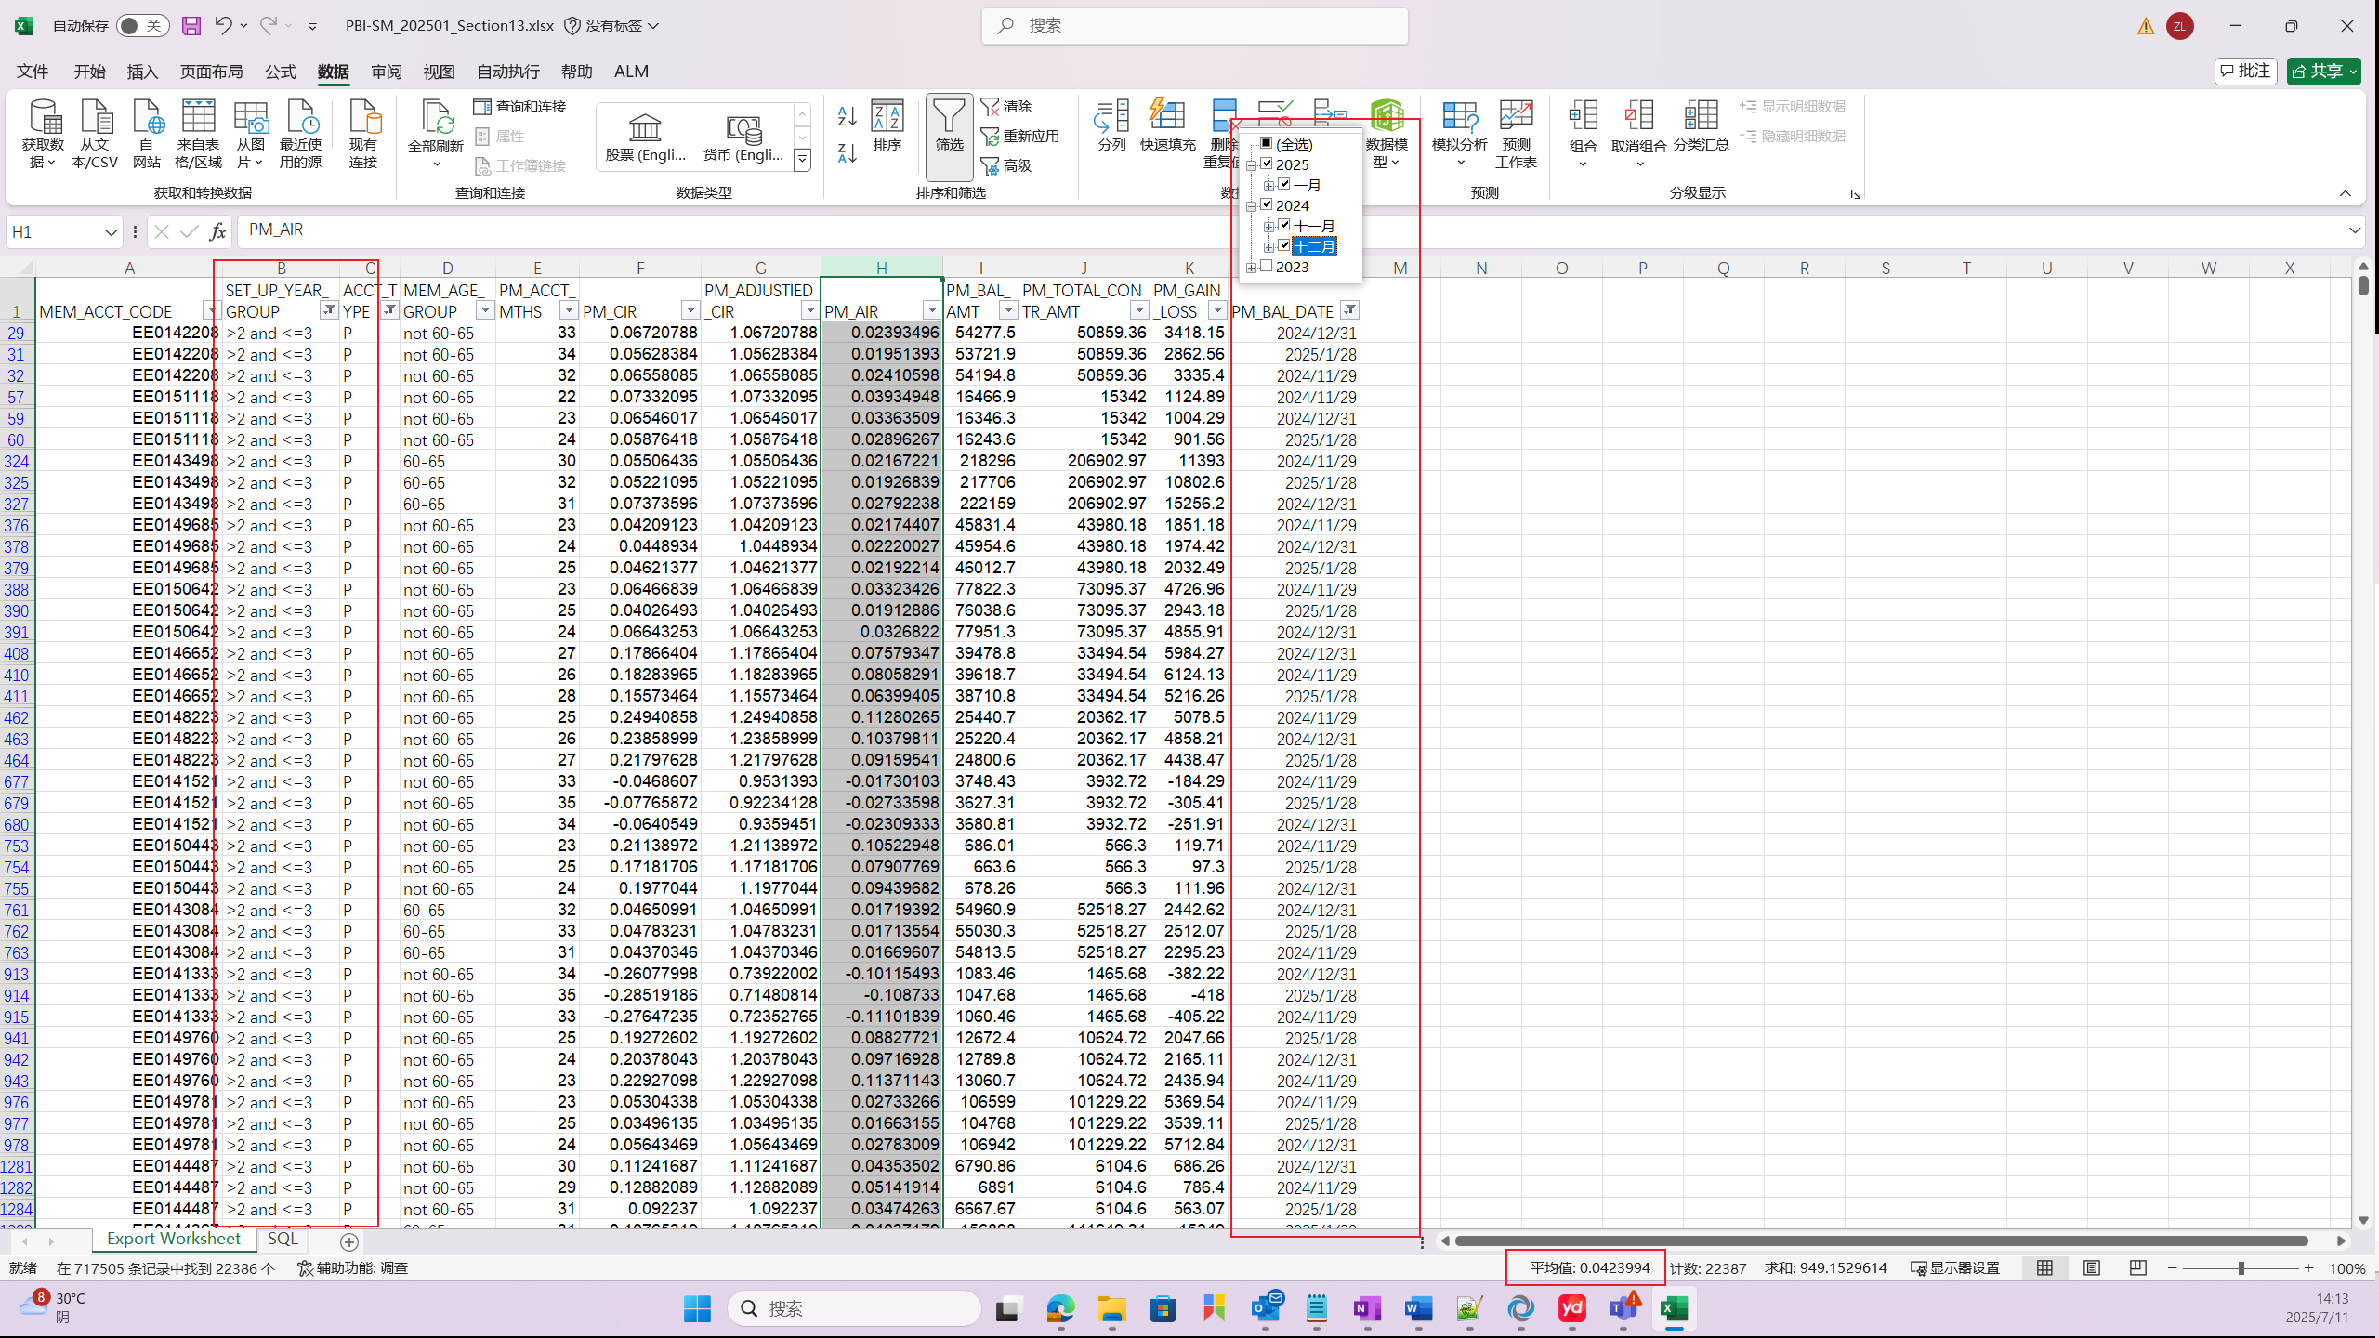
11
Three Month:
Average AIR of “Three Months + Personal account + (number of years: >2 and <=3)”

Slide 15
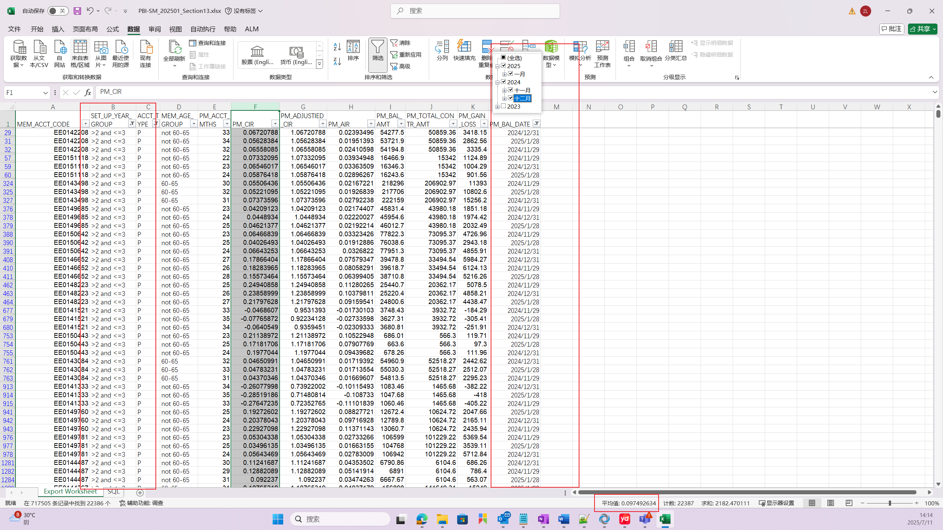
12
Three Month:
Average CIR of “Three Months + Personal account + (number of years: >2 and <=3)”

